Slide 1
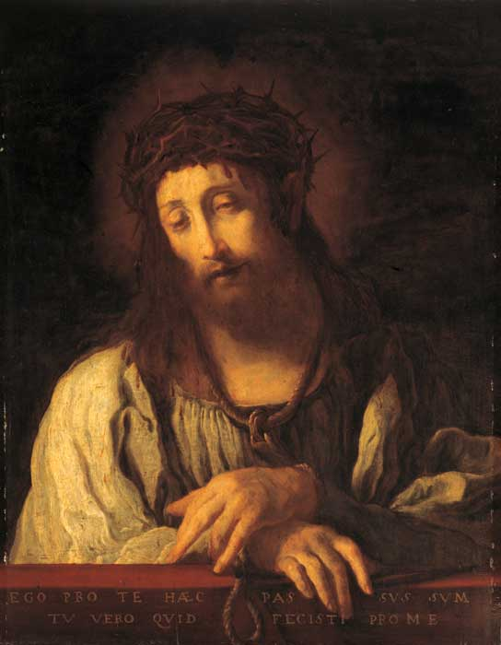
Domenico Feti
1589-1623
Ecce Homo: “Behold the Man”
“This I have suffered for you, now what will you do for me?”

